Slide 1












МедИновейт

Slide 2
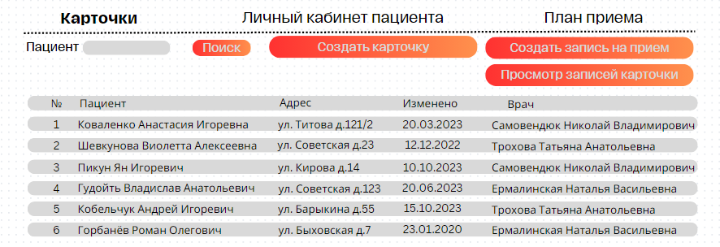
Регистратура
You can simply impress your audience and add a unique zing and appeal to your Presentations. I hope and I believe that this Template will your Time, Money and Reputation.

Slide 3
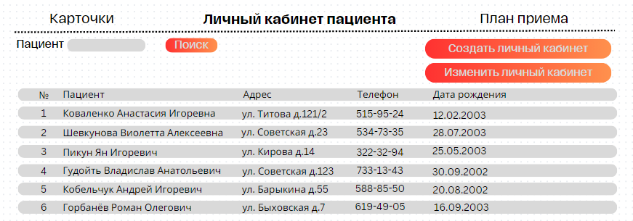
Регистратура
You can simply impress your audience and add a unique zing and appeal to your Presentations. I hope and I believe that this Template will your Time, Money and Reputation.

Slide 4
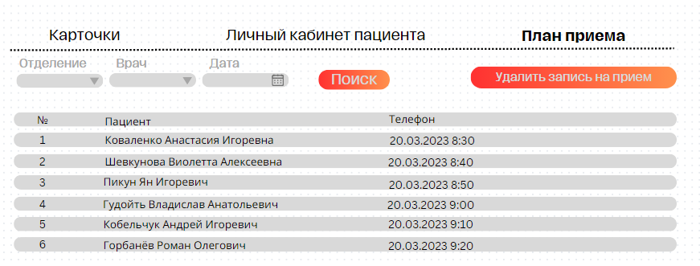
Регистратура
You can simply impress your audience and add a unique zing and appeal to your Presentations. I hope and I believe that this Template will your Time, Money and Reputation.

Slide 5
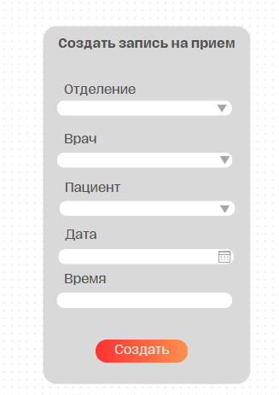
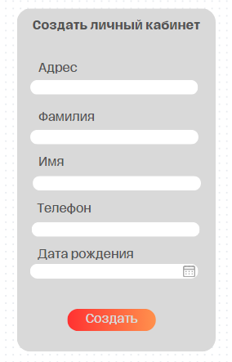
Регистратура
You can simply impress your audience and add a unique zing and appeal to your Presentations. I hope and I believe that this Template will your Time, Money and Reputation.

Slide 6
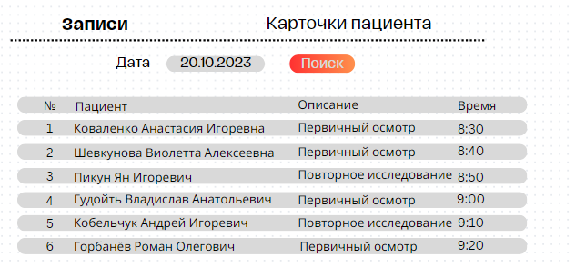
Врачебная документация
You can simply impress your audience and add a unique zing and appeal to your Presentations. I hope and I believe that this Template will your Time, Money and Reputation.

Slide 7
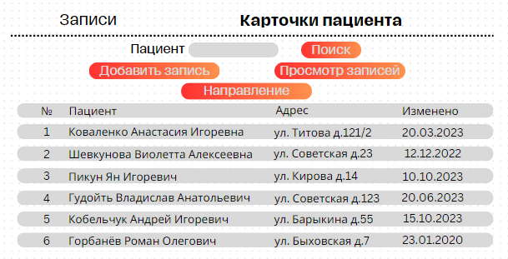
Врачебная документация
You can simply impress your audience and add a unique zing and appeal to your Presentations. I hope and I believe that this Template will your Time, Money and Reputation.

Slide 8
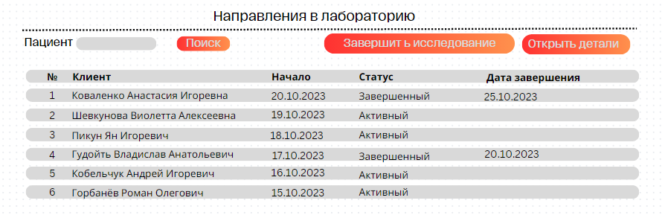
Клинико-диагностическая
лаборатория

Slide 9
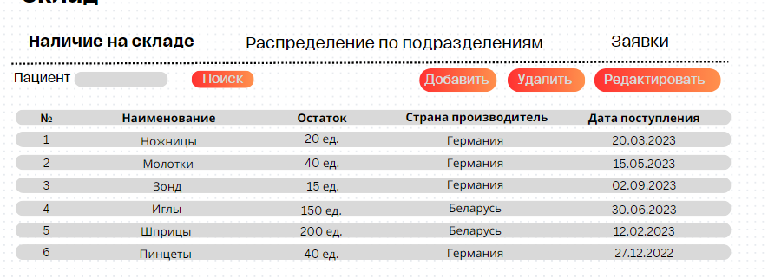
Склад
You can simply impress your audience and add a unique zing and appeal to your Presentations. I hope and I believe that this Template will your Time, Money and Reputation.

Slide 10
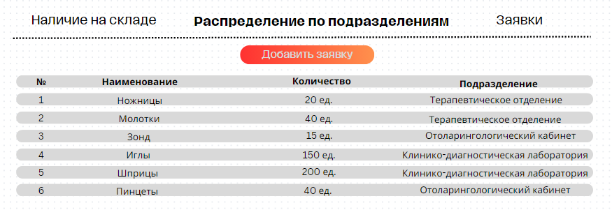
Склад
You can simply impress your audience and add a unique zing and appeal to your Presentations. I hope and I believe that this Template will your Time, Money and Reputation.

Slide 11
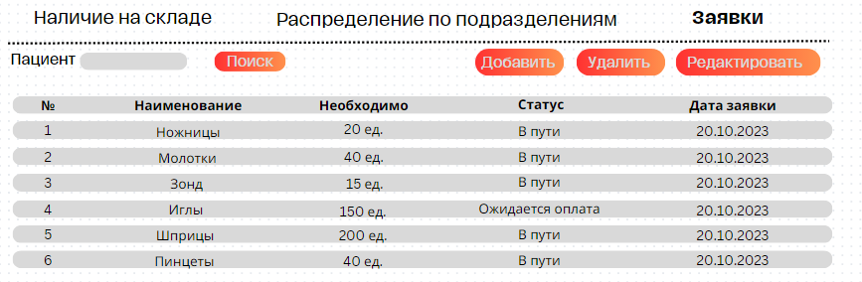
Склад

Slide 12
Спасибо за внимание

